Slide 1
REMOTE CONTROLLED SPY ROBOT
Team Name : TRaILBLAZERS
Dept. ECE 3rd Semester
ABHISHEK SARKAR (32)
ANKITA BASAK (55)
SHINJINI DAS (24)

Slide 2

INTRODUCTION
Robotics is an interesting field where every engineer can show his creativity and versatility.
Wireless cameras now-a-days have a wide usage all over the world for defense, investigation and security purposes.
The combination and implementation of these 2 technologies give rise to a new application.

Slide 3
IDEA OF THE PROJECT
This project involves the designing of a spy robot which can be controlled by a remote.
The remote has four switches to control the robot in four directions. The maximum controllable range is 125 meters.
The robot senses the surroundings through a CCD camera and sends to the receiver through the Radio Frequency wireless communication (RF technology).

Slide 4
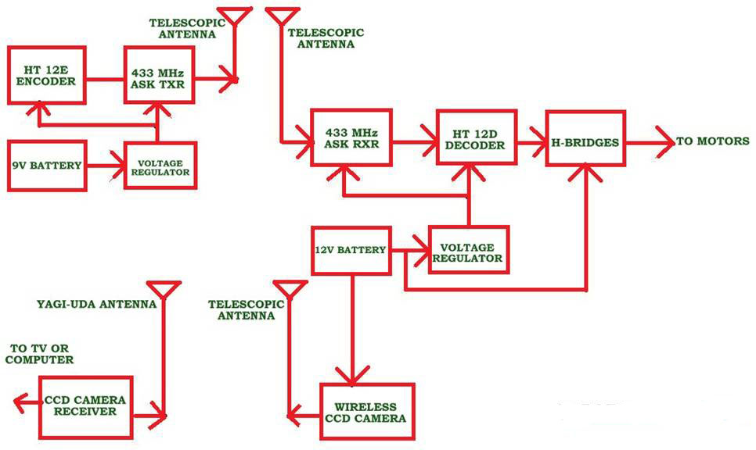
PLANNING & ASSEMBLANCE

Slide 5
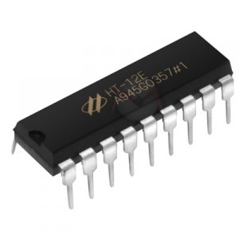
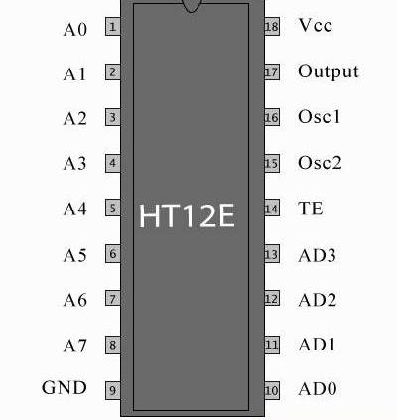
CIRCUIT COMPONENTS
HT12E Encoder :
It is an encoder integrated circuit of 2¹² series of encoders.
mainly used in interfacing RF and infrared circuits.
encodes the 12 bit parallel data into serial for transmission through an RF transmitter.

Slide 6
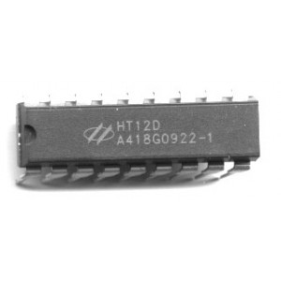
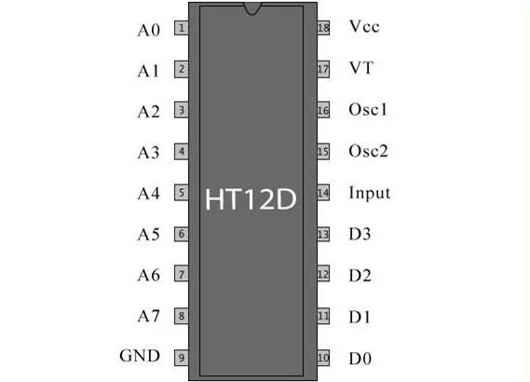
HT12D Decoder :
It is a decoder integrated circuit that belongs to 2¹² series of decoders.
mainly used for remote control system applications, like burglar alarm, car door controller, security system etc.
decodes the serial addresses and data received by a RF receiver into parallel data and sends them to output data pins.

Slide 7
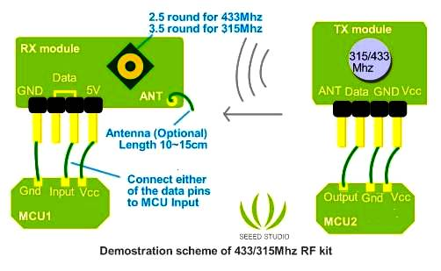
RF 433MHz Transmitter & Receiver :
It is operated on Radio Frequency wireless communication.
Frequency: 433Mhz.
Modulation: ASK
Receiver Data Output: High - 1/2 Vcc, Low - 0.7v
Transmitter Input Voltage: 3-12V (high voltage = more transmitting power)
Receiver Input Voltage : 3.3-6V (high voltage = more receiving power)

Slide 8
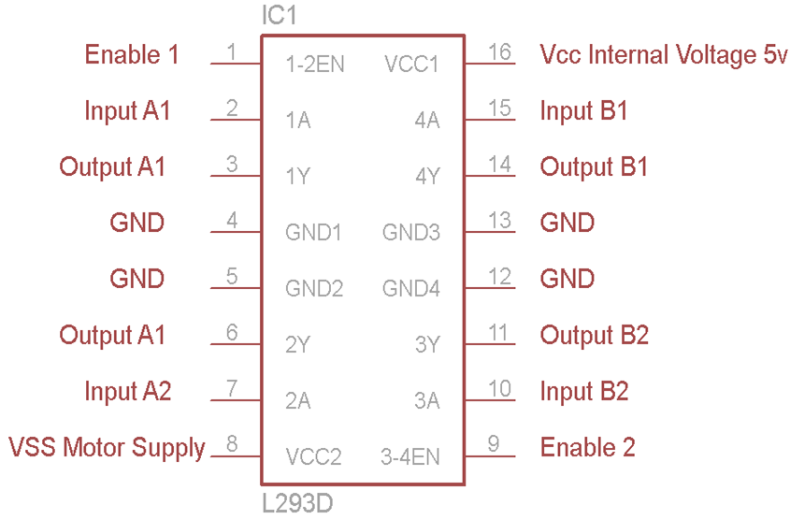
L293D Motor Driver :
L293D is a typical Motor driver IC which allows DC motor to drive on either direction.
A single L293D IC can control two DC motor.

Slide 9
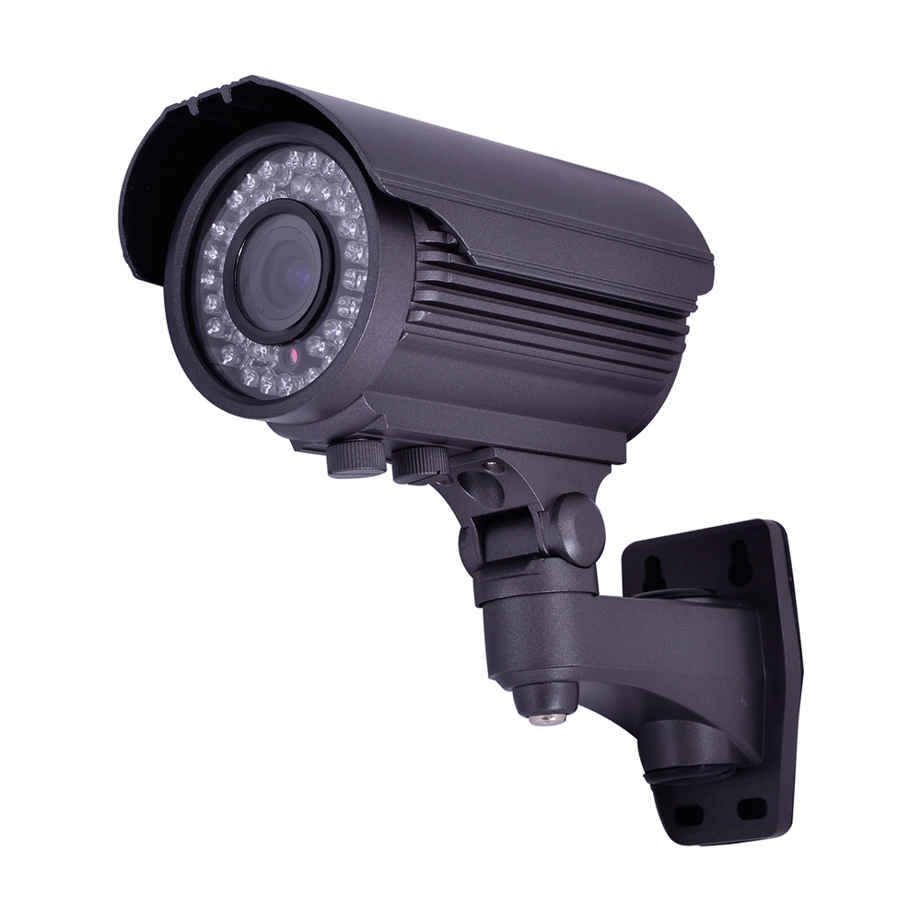
Wireless CCD Camera :
CCD – Couple Charged Device
CCD cameras are a type of image-capturing device that utilize an image sensor to register visible light as a recordable electronic signal to visually archive captured stills and video.

Slide 10
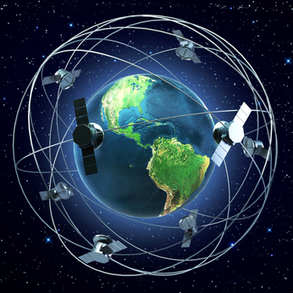
APPLICATION DEVELOPMENT:
This type of a model finds a lot of use in defence systems.
It is also helpful in investigation purposes & sting operations where it is used as a spy-cam.
RF technology is used to control this robot which limits its range of operation.
But with the help of satellite communication, this barrier can be overcome.

Slide 11
CONCLUSION
The idea of our project was drawn from a few English movies & recent developments on spy & CCTV cameras.
Studying about different components inspires us to make the project plan stronger.
In our next step, we would start building our project, the completion & operation of which would fulfil our experiment.
We hope that our efforts would be fruitful.

Slide 12
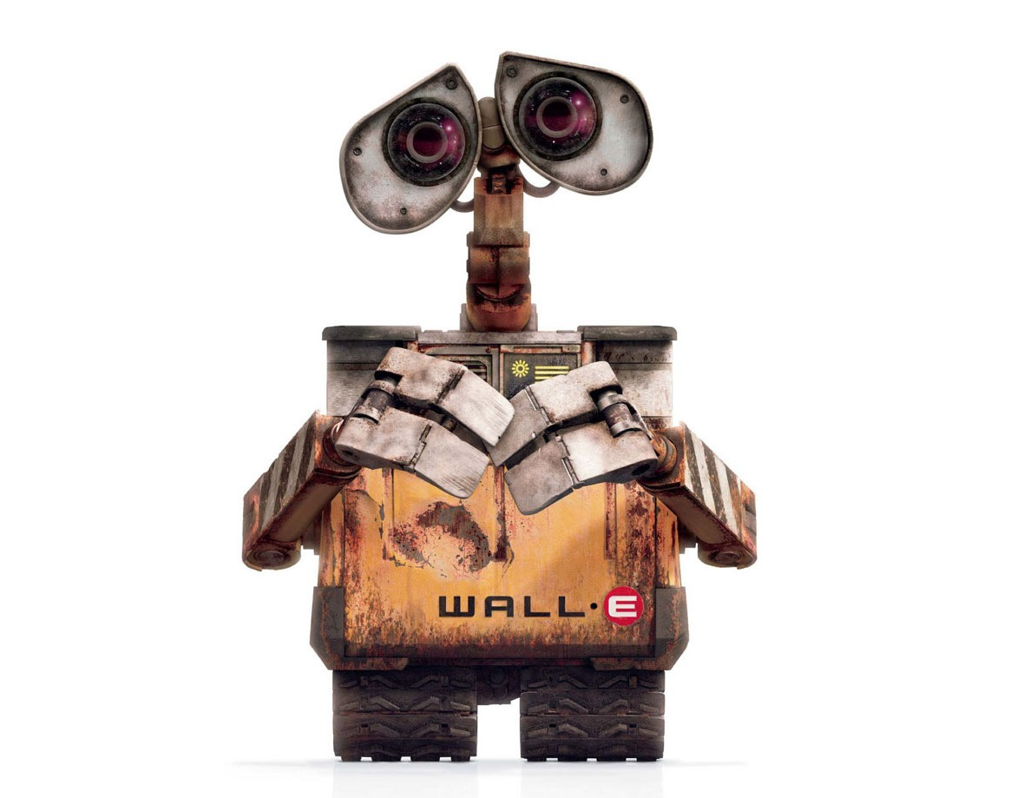
THANK YOU

